Slide 1
3d-Printed Granular Jamming Hand
Melissa Indoe
Chris Kang
Sean Phelan
Maggie Serra
Chris Wallace

Slide 2
Introduction
Project Objective
Problem Statement
Project Impact
Deliverables for Next Semester
All this belongs to Sean

Slide 3
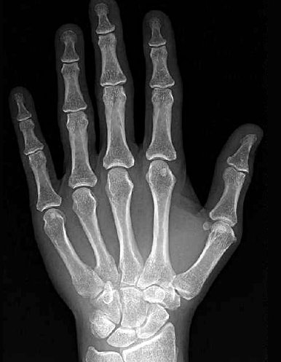
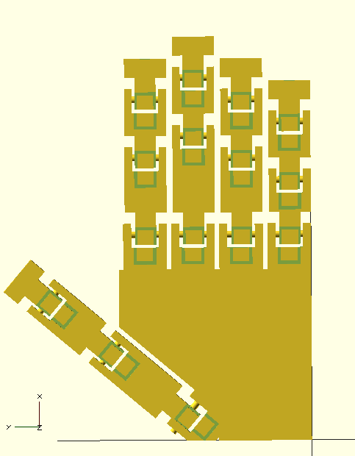
Project Review
In order for the project to meet all of the objectives stated, the team needed to design a prosthetic that mimicked a human hand in appearance, size, weight, and function
These criteria can be broken down into two main subsystems:
3D printed fingers/palm/forearm
granular jamming pad

Slide 4
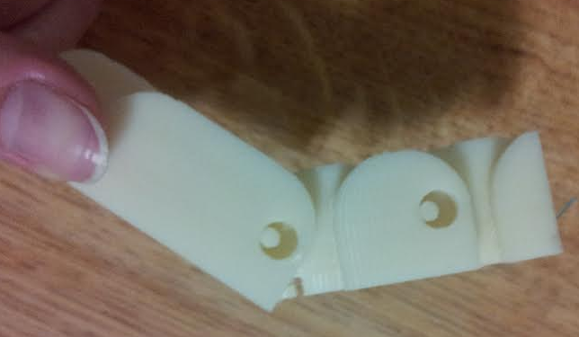
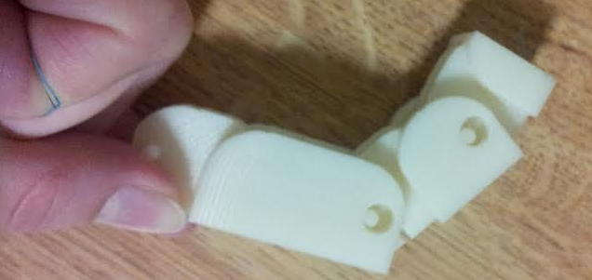
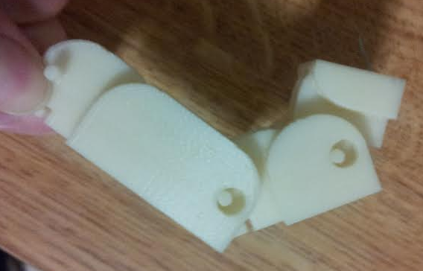
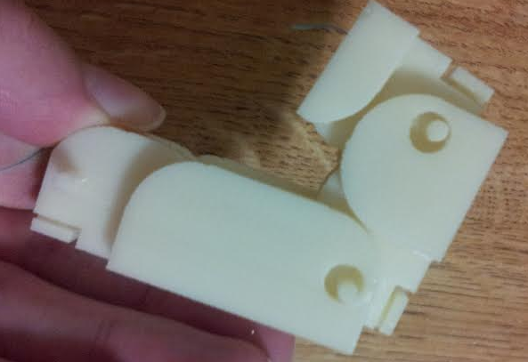
3D Printed Segments
Fully functional fingers have already been designed, modeled, and manufactured
The palm has been modeled and is ready for manufacture
The team has decided to modify an existing open-source forearm housing
This is because modeling curves in OpenSCAD can be complex
Additionally, the forearm is not the focus of the project
Finger prototype demonstrating full range of motion.

Slide 5
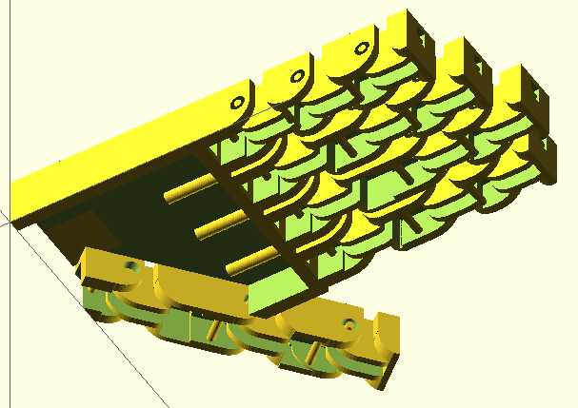
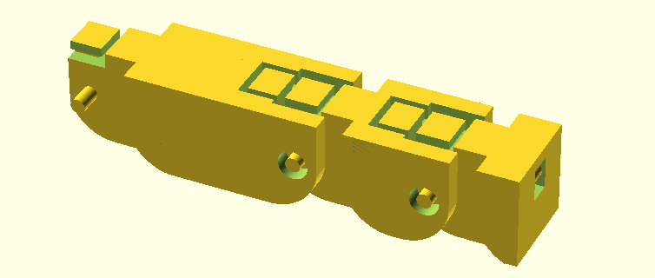
Finger and Palm
Iterative Design—The team has already developed a fully functional finger
Other parts of the design (mainly the palm), will require further iterations to come to a fully functional system

Slide 6
Granular Jamming Pad
Aids with grasping small or irregularly shaped objects
Will consist of one pad on the palm of the hand
Pad will be made with silicon and filled with coffee grounds
Silicon can easily be slip-cast to create irregular shapes
Coffee grounds are cheap, readily available, and universally recognized as the most effective granular jamming material
When pressed around an object, the granules will be forced into a tightly packed arrangement by removing the air with a vacuum
This allows the pad to pick up objects that the fingers may not be able to manipulate

Slide 7
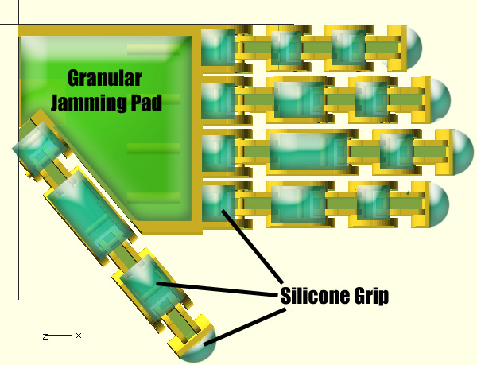
Location/Attachment of Pad
Granular jamming pad will be glued into the palm housing
Wire guides prevent the wire from snagging under the pad
Silicone grips will be glued to the flat surfaces of the fingers

Slide 8
Engineering Design
Electrical Considerations—Chris Wallace
Control Considerations—Chris Kang
Safety Considerations—Sean

Slide 9
Professional Drawings/Assembly Models
Maggie

Slide 10
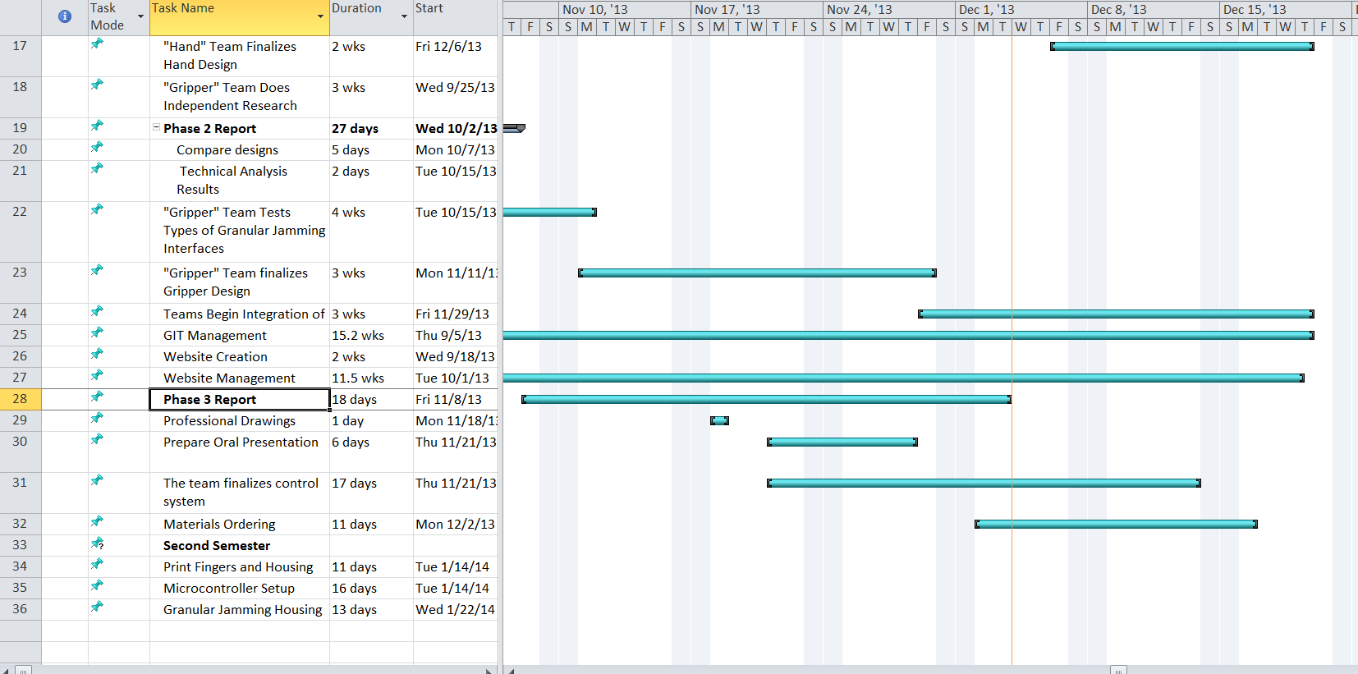
Gantt Chart

Slide 11
Bill of Materials
Sean

